Slide 1
Clark County’s Draft Five-Year Consolidated Plan
Notes:
Required every 5 years by HUD for CDBG and HOME funds
Asking for community input on the Plan which includes priority needs and goals
Plan is for Clark County, outside the Vancouver city limits; Vancouver is its own jurisdiction

Slide 2
Clark County Area Median Income
Percent of Median Income | Number in Household
 | 1 | 2 | 3 | 4 | 5 | 6 | 7 | 8
100% | 48,550 | 55,500 | 62,450 | 69,400 | 74,950 | 80,500 | 86,050 | 91,650
80% Low Income | 38,850 | 44,400 | 49,950 | 55,500 | 59,950 | 64,400 | 68,850 | 73,300
60% | 29,160 | 33,360 | 37,500 | 41,640 | 45,000 | 48,360 | 51,660 | 55,020
50% Very Low Income | 24,300 | 27,800 | 31,250 | 34,700 | 37,500 | 40,300 | 43,050 | 45,850
30% | 14,600 | 16,650 | 18,750 | 20,800 | 22,500 | 24,150 | 25,800 | 27,500
Portland-Vancouver-Hillsboro, OR-WA MSA
Source: U.S. Department of Housing and Urban Development, effective January 22, 2014, for CDBG funds, and May 1, 2014, for HOME funds.
Notes:
Income is based on metropolitan statistical area.
CDBG and HOME funds can only go up to 80% AMI; some programs are restricted to 60% AMI

Slide 3
CDBG National Objectives
1. Limited Clientele
Battered Spouses
Elderly (62 years and older)
Disabled Adults – Physical or Mental
Illiterate Adults
Persons Living with AIDS
Migrant Farm Workers
2. Housing
Households with income at or below 80% of the Area Median Income
3. Area Benefit

Slide 4
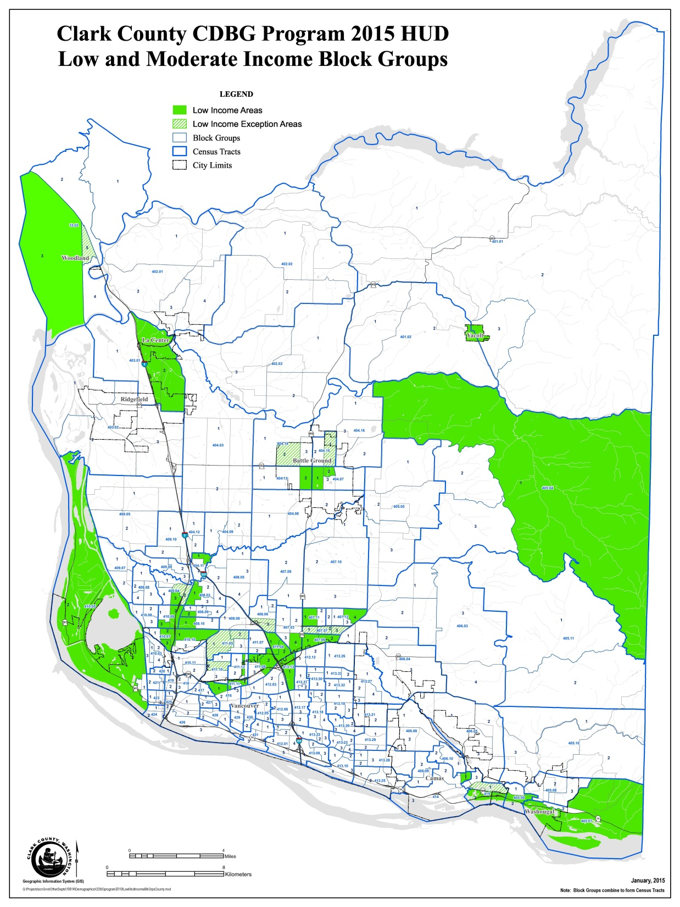

Slide 5
Notes:
This chart looks at income and housing trends.
Median income has risen 9%
Fair Market Rent has risen 25%
Median Home price has declined 14%
Rents are going up almost 3 times as fast as income

Slide 8
Notes:
One measurement watched closely by HUD is cost burden; how much of a households income is used to pay for housing.
Housing costs for renters = contract rent and utilities
Affordable housing = household paying less than 30% of their income towards housing
Households earning lower incomes are paying a higher proportion of their income for housing
Households paying more than 50% are at greatest risk due to a catastrophic event (hospital bills, auto repairs)

Slide 9
Clark County Owner Cost Burden:
2007-2011
Notes:
Housing costs for owners = mortgage, utilities, association fees, insurance and real estate taxes (property taxes)
Some owners do not have a mortgage; only paying utilities, insurance and taxes; makes housing more affordable.
Generally, the higher the income the lower the cost burden.

Slide 10
Notes:
The percent of renter households by income range

Slide 11
Notes:
The percent of units that have rent that would be affordable to households in that income range

Slide 12
Notes:
Compares the percent of households with the number of units.
There are 480 households earning 80% and above AMI who are renting units affordable to those earning 0-30% AMI.

Slide 13
Clark County Point in Time Count
Sheltered and Unsheltered
Notes:
Homelessness is trending down as determined through the Point in Time Count; a one-day event every January
Volunteers canvas known campsites
Shelters
Project Homeless Connect conducted same day as count
Reasons for declining counts:
Additional funding from Document Recording Fees
2005 first homeless plan – focus on ending homelessness
Better coordination among service providers

Slide 14
2014 Point-in-Time Homeless Subpopulations
Homeless Subpopulation | Persons who are Homeless
Chronically Homeless Individuals | 9%
Severely Mentally Ill | 17%
Chronic Substance Abuse | 8%
Veterans | 7%
Victim of Domestic Violence | 17%
72 percent of persons in homeless families with children were under the age of 18.
Notes:
Some characteristics of people who are homeless
Information is self-identified
Could fall into more than one category
95% of veterans who are homeless are men

Slide 15
2015 – 2019 Consolidated Plan Draft Priority Needs
A. Affordable Housing Development and Preservation B. Community and Neighborhood Sustainability C. Alleviation of Homelessness
Notes:
Broad categories

Slide 16
Affordable Housing Development and Preservation Goals
1. Increase Housing Supply:
Increase the supply of housing in urban growth areas that is affordable to renter households earning 60 percent or less of Area Median Income (AMI). Projects should serve households with a range of incomes, provide a variety of unit sizes, incorporate universal design, and meet recognized sustainability standards.
Outcome: Affordability
Objective: Decent Housing
Outcome Indicator: Rental Units Constructed
2. Preserve Housing:
Preserve existing affordable housing threatened with loss due to condition, location, expiring federal contracts, redevelopment efforts, lead-based paint, or other situations, through acquisition and/or rehabilitation.
Outcome: Availability/Accessibility
Objective: Decent Housing
Outcome Indicator: Rental and Homeowner Units Preserved
3. Promote Homeownership:
Promote homeownership opportunities for low- and moderate-income households, including persons with disabilities and first-time homebuyers.
Outcome: Affordability
Objective: Decent Housing
Outcome Indicator: Homeowner Units
Notes:
Examples:
ACE develops new apartment complexes
ACE purchases and rehabs apartment complexes
Proud Ground Homeownership program, Evergreen Habitat for Humanity

Slide 17
Community and Neighborhood
Sustainability Goals
1. Community Facilities:
Acquisition and/or improvements of community facilities that provide services to low-income, elderly, or special needs persons.
Outcome: Sustainability
Objective: Suitable Living Environment
Outcome Indicator: Persons Assisted
2. Community Infrastructure:
Infrastructure improvements (streets, sidewalks, storm drainage, water, and sewer) needed in eligible low income neighborhoods and communities (consistent with neighborhood/community plans). Acquisition and/or improvements to parks and recreation facilities to improve the livability of low- and moderate-income neighborhoods (consistent with neighborhood/community plans). Facilities should meet sustainability standards.
Outcome: Sustainability
Objective: Suitable Living Environment
Outcome Indicator: Persons Assisted
3. Economic Vitality:
Encourage community economic vitality through activities that build a diverse economic base, enhancing the opportunity for low-income persons to become financially independent.
Outcome: Sustainability
Objective: Creating Economic Opportunities
Outcome Indicator: Persons Assisted
Notes:
Examples:
Senior Centers
Streets and sidewalks in several communities
Economic Development programs

Slide 18
Alleviation of Homelessness Goals
1. Families with Children.
Outcome: Availability/Accessibility
Objective: Decent Housing
Outcome Indicator: Persons Assisted
2. Unaccompanied Youth.
Outcome: Availability/Accessibility
Objective: Decent Housing
Outcome Indicator: Persons Assisted
3. Chronically Homeless.
Outcome: Availability/Accessibility
Objective: Decent Housing
Outcome Indicator: Persons Assisted
4. System-Wide Improvement:
Improvement of the overall performance, efficiency, and accountability of the homeless system.
Outcome: Availability/Accessibility
Objective: Decent Housing
Outcome Indicator: Persons Assisted
Notes:
Based on the current 10-Year Homeless Plan; currently being updated.
The CFTH will be soliciting feedback from the community.
The new Homeless Plan will be completed before the Con Plan is completed and will be incorporated into this Plan.
The new Homeless Plan will focus on 3 populations: Families with Children, Unaccompanied Youth and Chronically Homeless.
New plan will also focus on system improvements

Slide 19
Survey is located at www.clark.wa.gov/cdbg
Notes:
Survey open through January for persons who live in Clark County, but outside the Vancouver city limits

Slide 20
Thank You
Feedback on the Five-Year Consolidated Plan can be provided by:
Completing the survey located at www.clark.wa.gov/cdbg
Emailing Rebecca Royce or Pete Munroe at
Rebecca.Royce@clark.wa.gov
Pete.Munroe@clark.wa.gov
Mailing information to:
Clark County Department of Community Services
c/o Pete Munroe
PO Box 5000
Vancouver, WA 98666-5000

