Slide 1
Covid-19 Response
Washington Low Income Housing Alliance

Slide 2
Federal Advocacy…

Slide 3
Can you make a Strong Push for Federal Resource Needs?
$11.5 billion in Emergency Solutions Grant (ESG) funding
$8.5 billion to keep Public Housing Authorities, like the VHA operating at full capacity
National Moratorium on Homeless Encampment Sweeps by following the Centers for Disease Control and Prevention
$100 billion in Rental Assistance to keep people housed
National Moratorium on Evictions and Foreclosures
Robust Resources for Housing Counselors and Legal Services
Call to Action

Slide 4
We need your Voice!
Call your Congressperson!
Tell Jaime Herrera Beutler about the resources your community needs!

Slide 5
StaTe Advocacy…

Slide 6
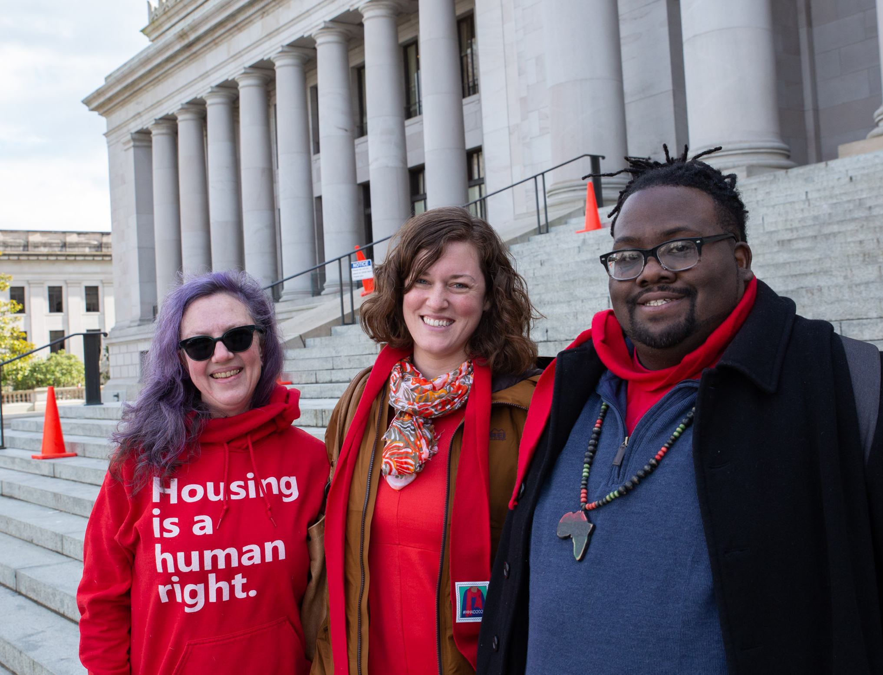
Washington: Special Legislative Session
State economy experiencing a budget deficit
We need a huge advocacy push from you: “DO NOT CUT PROGRAMS!”
Please Sign Up for our Action Alerts

Slide 7
Talk to us…

Slide 8
We want to hear from you!
Let us know about an emerging or unmet need related to affordable housing or homelessness in your community.
Share a personal or community story about the impact of COVID-19. Sharing these stories can help policy makers better understand the response needed.
Share a success story or best practice. Let us know so we can share this information to keep resources flowing and provide ideas that could help others.
Ask a question regarding the state’s COVID-19 response efforts related to affordable housing and people experiencing homelessness.
Complete this form to ensure our advocacy is guided by information about what is happening in your community.

Slide 9
Join RAP…

Slide 10
Join the Resident Action Project (RAP)
Vancouver is host to our first Local Organizing Committee with our partner, REACH – Please join our RAP member calls!
We want to get to know people in affordable housing
RAP will host a Town Hall in June with Poverty Action Network
Voter Registration and policy education
Get Out The Vote

Slide 11
Learn more…

Slide 12
Weekly Stakeholder Covid-19 Calls
Register each week to attend call
Watch recordings from previous calls
Dept. of Commerce representatives answer questions
Washington regional updates
State budget and policy updates
Federal updates
Past speakers: Rep. Pramila Jayapal, local and statewide lawmakers, Alliance member organizations, National Low Income Housing Coalition, and many more.
This week: Rep. Denny Heck
Q&A and shared information and resources amongst attendees

Slide 13
Final note…

Slide 14
Don’t forget that This is an Important Election Year. Please help voter registration efforts!

Slide 15
Thank you!
Caroline Lopez
Director of Organizing
carolinel@wliha.org

